Slide 1
SEU Event Pass
Attendance Tracking and Student Engagement

Slide 2
SEU Event Pass
Attendance Tracking in Collegiate Link thru SEU Event Pass and the Campus Labs Check In
Real Time Tracking
Campus Email Export
Mobile Device Friendly

Slide 3
Two items need
SEU Event Pass
Every student has a unique pass available in Collegiate Link
Campus Labs Check In App
Available in the app store
Used to scan SEU Event Passes

Slide 4
Accessing SEU Event Pass

Slide 5
Accessing SEU Event Pass
On a mobile device, open MyHilltop
In MyHilltop, search for Collegiate Link
Sign into Collegiate Link, click on your profile
Click on Event Pass, save to your phone wallet or screen shot

Slide 6
Accessing SEU Event Pass

Slide 7
Using Campus Labs Check In App

Slide 8
Using Campus Labs Check In App
Event tracking with the Campus Labs Check In App requires an approved event in Collegiate Link
Each approved event generates a unique Access Code
Each access code is entered in the Campus Labs Check In App to link the scanner with the Event.

Slide 9
Using Campus Labs Check In App

Slide 10
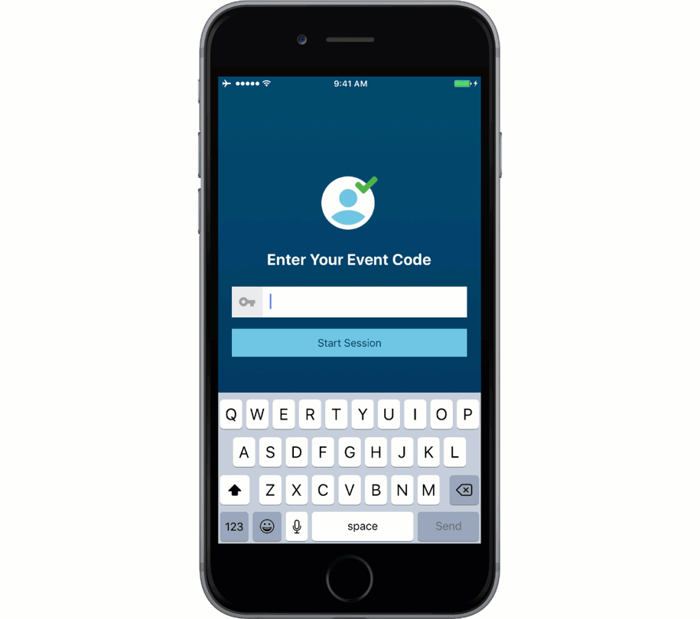
Using Campus Labs Check In App
Download Campus Labs Event Check-In app in your app store
Input the Access Code for your event
Sign into Collegiate Link

Slide 11
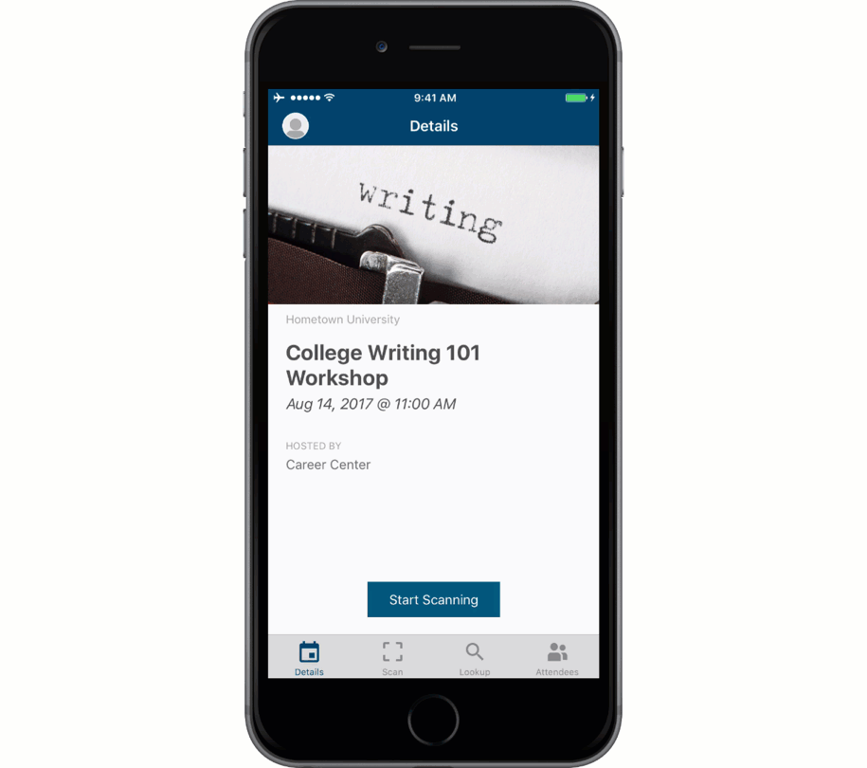
Using Campus Labs Check In App
Tap “Start Scanning” and your’ ready to Scan
Place the scanner above an SEU Event Pass
Make sure to select Check In

Slide 12
Using Campus Labs Check In App
If you come across an attendee with No Pass, select Look Up
Search for attendee by the name listed with the registrar or by campus email
Make sure to select Check In

Slide 13
Using Campus Labs Check In App
Any point you can view attendee list
Click Attendees to view real time attendance

